Slide 1
Bounding Box Improvement With Reinforcement Learning
Andrea Cleland
Master’s Thesis Defense
Portland State University
2018

Slide 2
1. Introduction

Slide 3
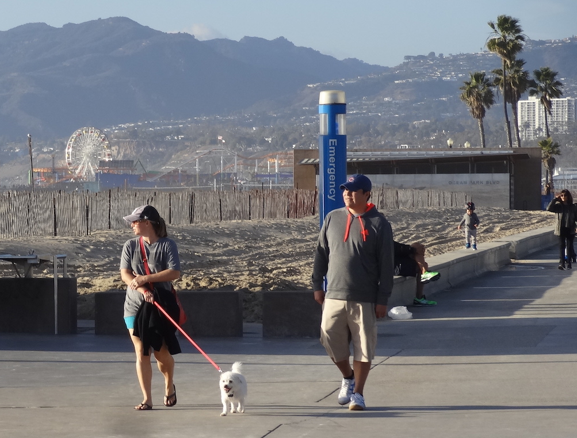
Object localization
Ferris Wheel
Person 2
Person 4
Person 1
Person 3
Dog
Task: identify and locate objects in images

Slide 4
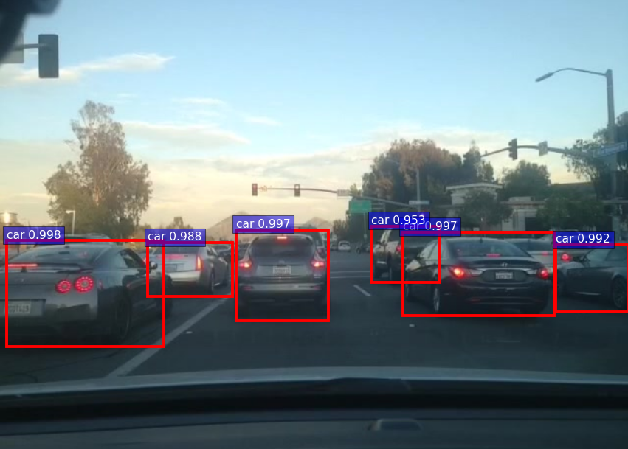
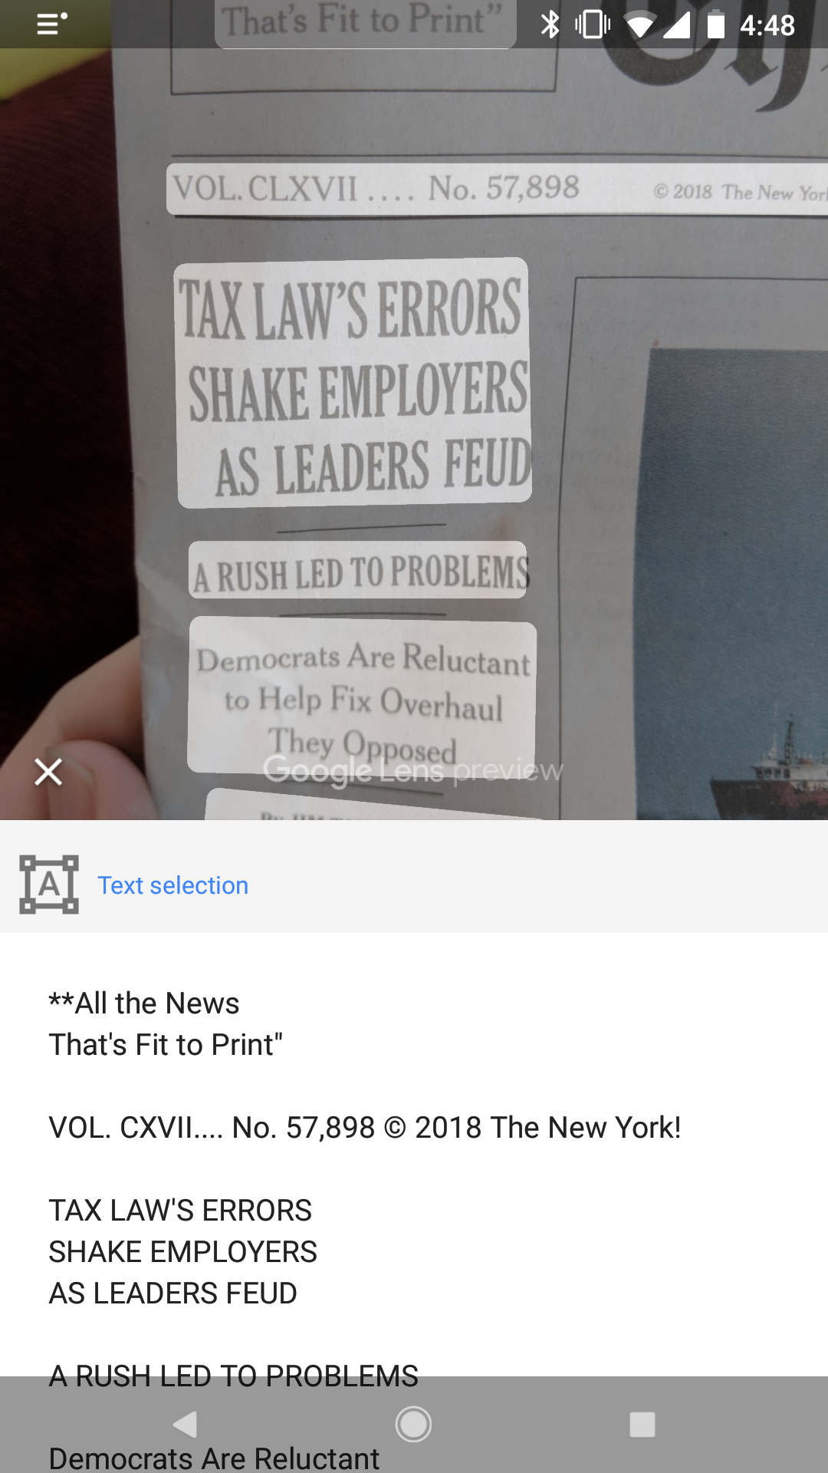
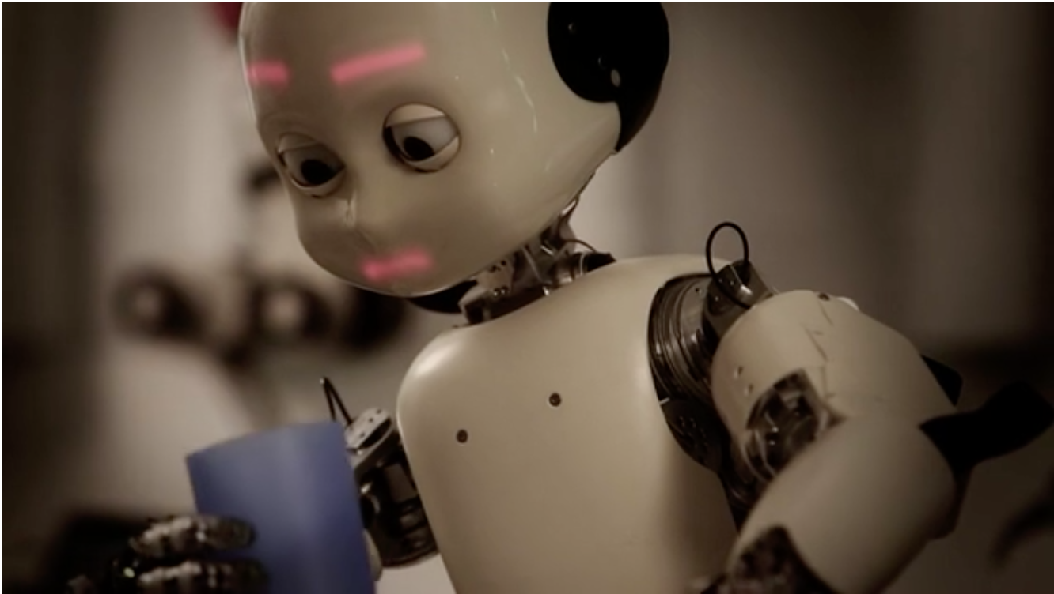
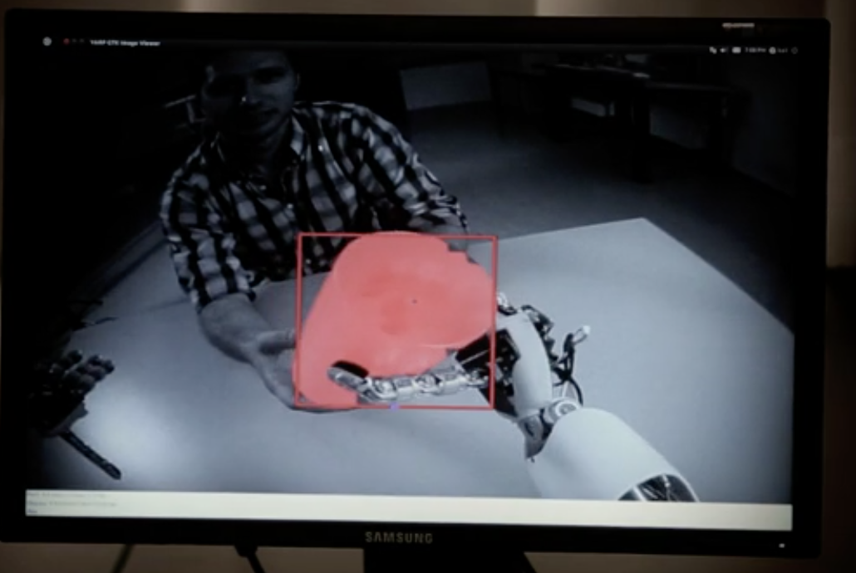
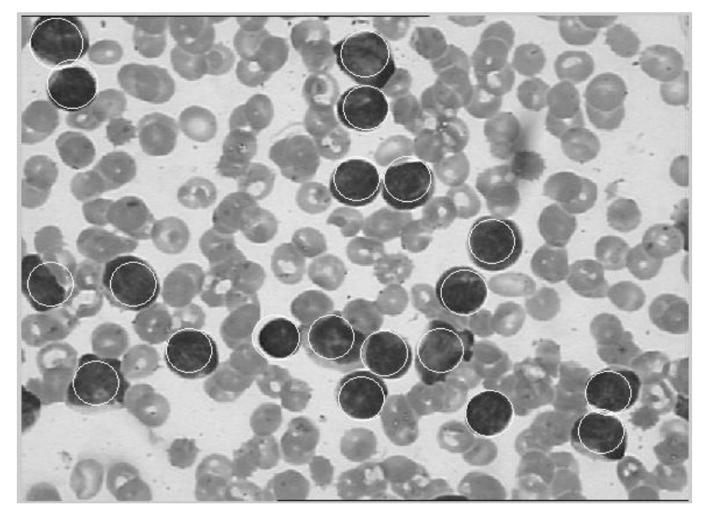
Object Localization Applications
Cell Phone Apps
Self-Driving Cars
Robot Control
Medical Diagnosis
Notes:
Video with robot picking up cup: https://www.azorobotics.com/Article.aspx?ArticleID=91

Slide 5
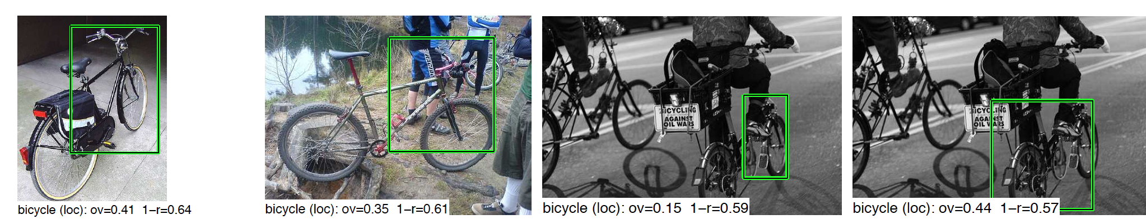
Object Localization
Convolutional Neural Networks are very good at identifying objects, but localization is still a challenge
RCNN False Positives [Source]
Notes:
Rich Feature Hierarchies for Accurate Object Detection and Semantic Segmentation R. Girshick, J. Donahue, T. Darrell, J. Malik IEEE Conference on Computer Vision and Pattern Recognition (CVPR), 2014 oral presentation

Slide 6
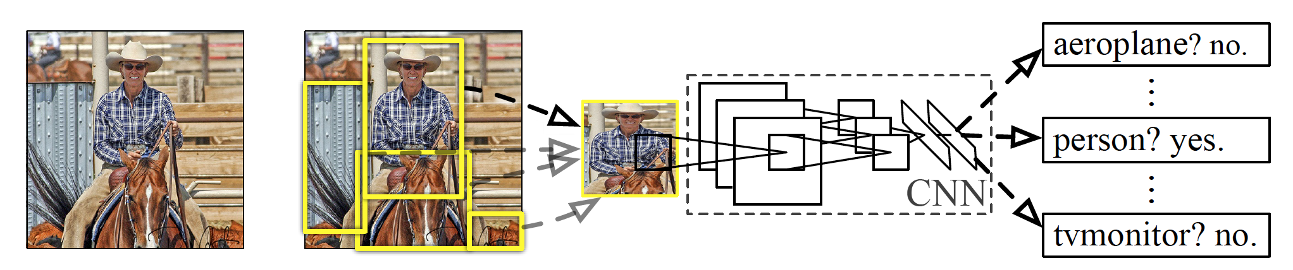
Object Search
Exhaustive sliding window approach is too slow
Need to economize search:
Generate object proposals based on likely locations
Then do local search for object
When CNN detector has a positive identification, the bounding box may be a poor fit.
Need way to adjust box
Notes:
[Source]

Slide 7
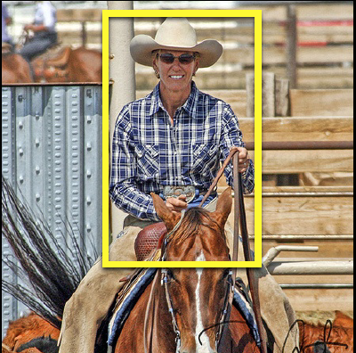
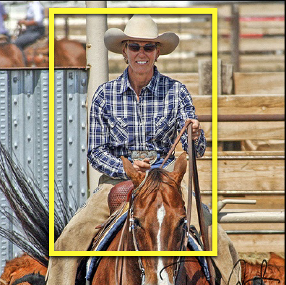
Bounding Box Regression (BBR)
Extract CNN Features from proposed bounding box
Estimate location and dimensions of true box through statistical regression on CNN features.
Bounding Box Proposal
Result of Bounding Box Regression

Slide 8
Ways to Improve Bounding Box Regression?
BB Regression is only applied once – based on static analysis of features.
Maybe an iterative active approach could work better?

Slide 9
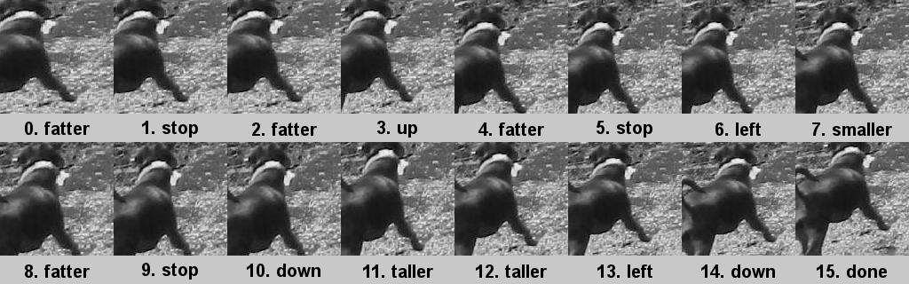
My Algorithm
Search policy aims to improve bounding box proposal through a sequence of transformative actions: {up, down, left, right, bigger smaller, fatter, taller, stop}
Search policy is learned using reinforcement learning.

Slide 10
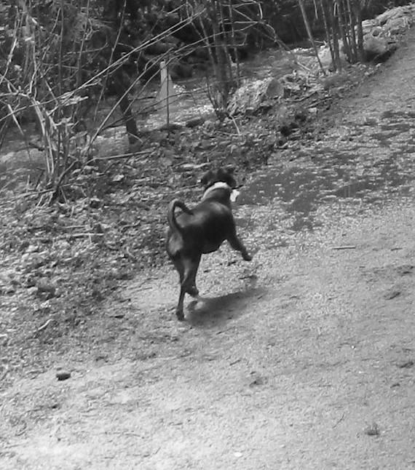
Initial box

Slide 11
Fatter

Slide 13
Up

Slide 15
Fatter

Slide 17
Left

Slide 19
Smaller

Slide 21
Fatter

Slide 23
Down

Slide 25
Taller

Slide 27
Taller

Slide 29
Left

Slide 31
Down

Slide 32
Done
Done

Slide 33
Reinforcement Learning
Machine Learning method that works by trial and error (like the way we learn)
Agent tries actions to complete a task
Positive rewards for advantageous behavior
Negative rewards for disadvantageous behavior
Repeat
Notes:
Image source: http://clipartix.com/dog-bone-clipart-image-22328/

Slide 34
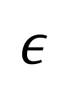
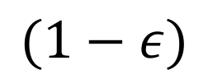
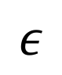
Epsilon-Greedy Algorithm
Exploration
Try random actions and see what happens
Exploitation
Do what has earned rewards in the past
$$ε$$
$$ε$$
$$(1−ε)$$
Notes:
- Important concept in reinforcement learning: tradeoff between exploration and exploitation
- Exploration: try new random actions and see what happens
- Exploitation: do what has earned you rewards in the past.
With probability epsilon, agent chooses action according to uniform random distribution
With probability 1-epsilon, agent chooses action based on best information (max Q value, but I haven’t gotten there yet)

Slide 35
Epsilon-Greedy Variations
Constant
Annealing – epsilon policy where epsilon is gradually reduced over the course of training
Early in training exploration emphasized, exploitation later in training.
Adaptive/Contextual – epsilon changes tied to learning progress or context.

Slide 36
Thesis Hypothesis:
I hypothesize that the Epsilon-greedy policy used during training matters for the performance of the search algorithm.
I perform experiments to compare performance between 4 different epsilon policies.
3 constant value: 0.75, 0.5, 0.25
1 linear annealing policy. ~0.9 in beginning to ~0.1 at end of training
I also explore the effect of the length of training (number of epochs)

Slide 37
2. Background

Slide 38
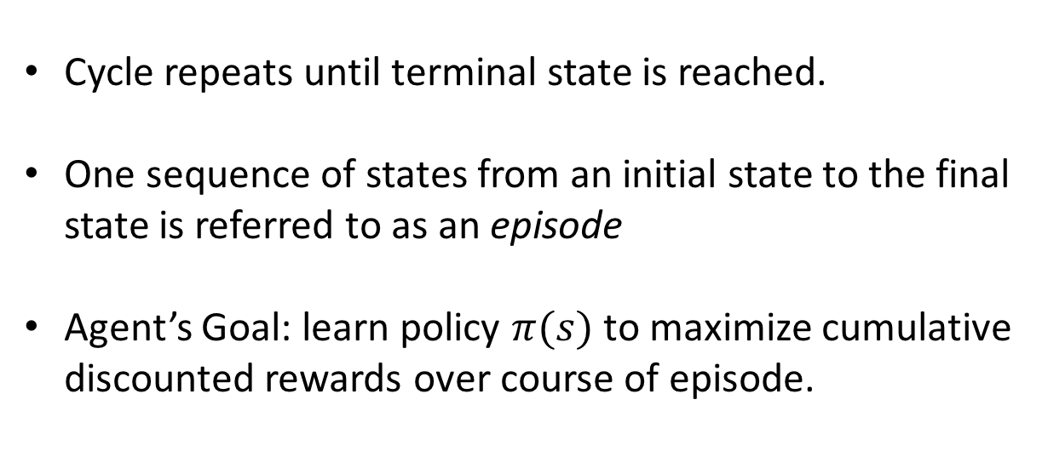
Reinforcement Learning (again)
Cycle repeats until terminal state is reached.
One sequence of states from an initial state to the final state is referred to as an episode
Agent’s Goal: learn policy $π(s)$ to maximize cumulative discounted rewards over course of episode.

Slide 39
States in my algorithm
Image, bounding box
Features extracted from box to inform the algorithm.
Action history
Last 10 actions taken
[left, left, up, fatter, smaller,…]
Notes:
Action history helps prevent the algorithm from getting “stuck.” Like in chess rules. 3 repeated positions = stalemate.

Slide 40
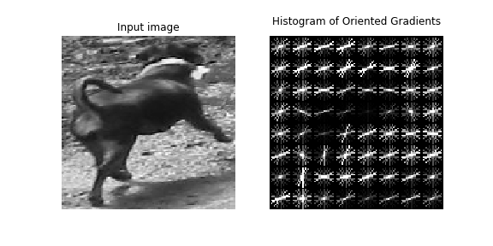
State Features - HOG
Histogram of Oriented Gradients (HOG) features.
Slopes of edges in images are computed
Organized into histograms binned by slope orientation.
Compiled (in my case) into a 2916-length vector
Notes:
- 6x6 array of blocks, each containing 3x3 array of cells, each containing 9-bin histogram.
-

Slide 41
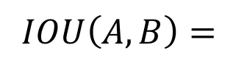
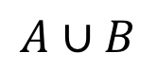
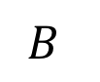
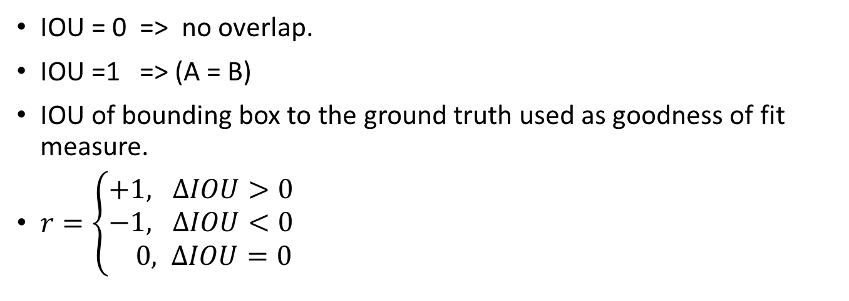
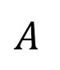
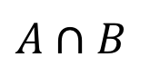
Reward Function: Intersection over Union (IOU
$$A$$
$$A∩B$$
$$IOU\left(A,B\right)=$$
$$B$$
$$A∪B$$
IOU = 0 => no overlap.
IOU =1 => (A = B)
IOU of bounding box to the ground truth used as goodness of fit measure.
$r=\left\{\begin{aligned}+1, ΔIOU>0 \\ −1, ΔIOU<0 \\ 0, ΔIOU=0\end{aligned}\right.$

Slide 42
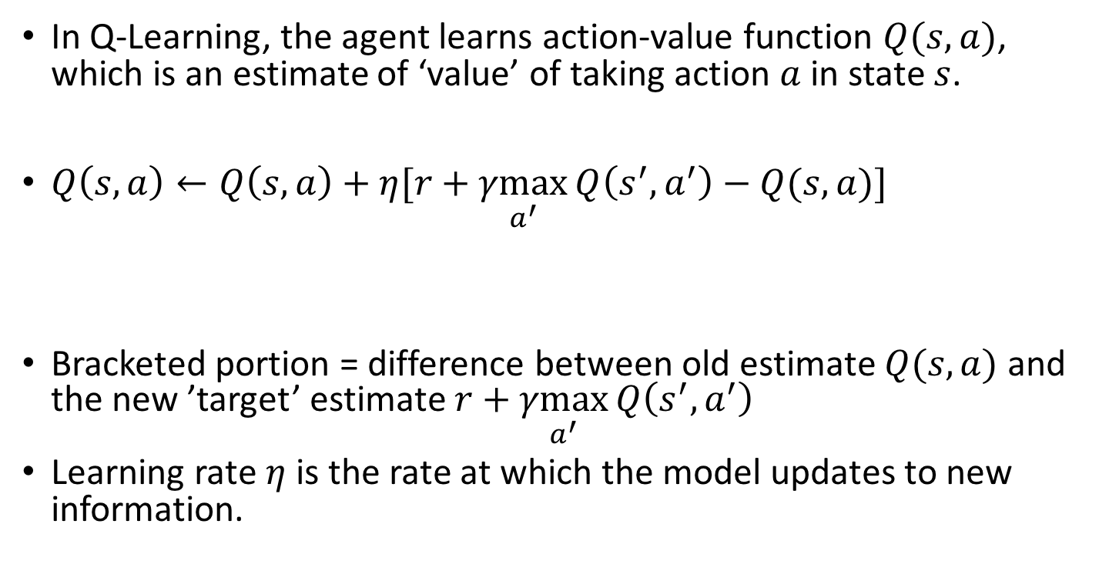
Q-Learning
In Q-Learning, the agent learns action-value function $Q(s,a)$, which is an estimate of ‘value’ of taking action $a$ in state $s$.
$Q\left(s, a\right)←Q\left(s,a\right)+η[r+\underset{a^{′}}{γmax}{Q\left(s^{′},a^{′}\right)−Q(s,a)]}$
Bracketed portion = difference between old estimate $Q(s,a)$ and the new ’target’ estimate $r+\underset{a^{′}}{γmax}{Q\left(s^{′},a^{′}\right)}$
Learning rate $η$ is the rate at which the model updates to new information.
Learning rate:
target

Slide 43
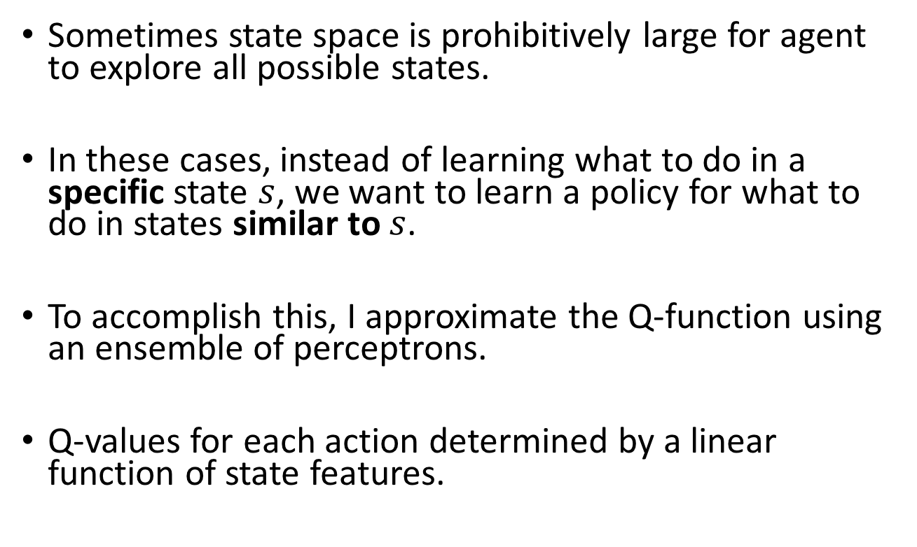
Q-Learning with Perceptrons
Sometimes state space is prohibitively large for agent to explore all possible states.
In these cases, instead of learning what to do in a specific state $s$, we want to learn a policy for what to do in states similar to $s$.
To accomplish this, I approximate the Q-function using an ensemble of perceptrons.
Q-values for each action determined by a linear function of state features.

Slide 44
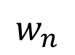

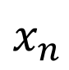
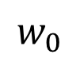
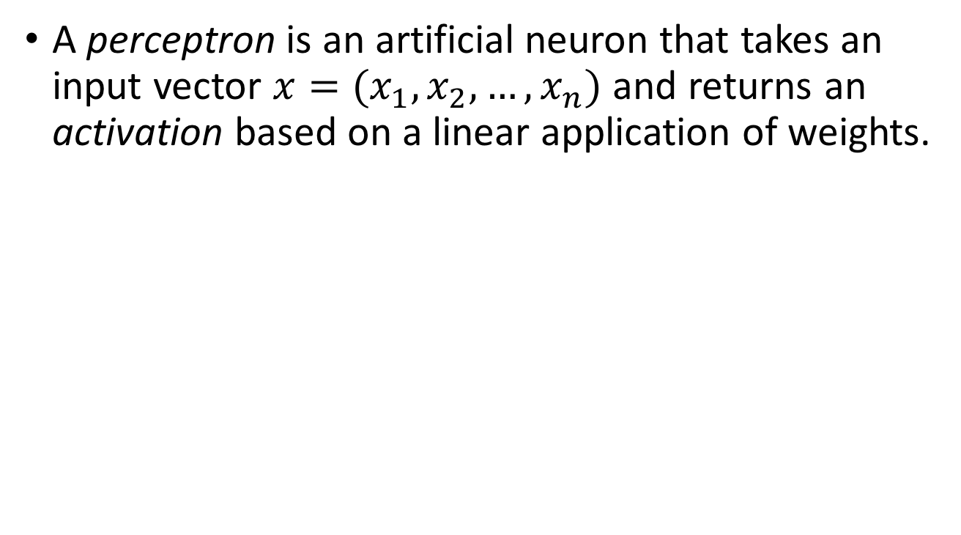
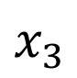
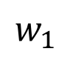
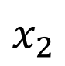
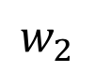
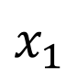
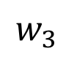
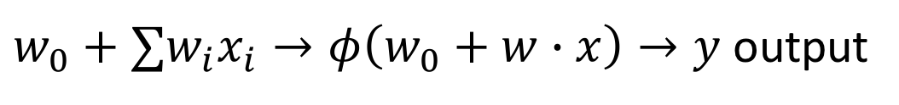
Perceptron
A perceptron is an artificial neuron that takes an input vector $x=(x_{1},x_{2}, …, x_{n})$ and returns an activation based on a linear application of weights.
$$1$$
bias
$$w_{0}$$
$$x_{1}$$
$$w_{1}$$
$$w_{2}$$
Activation function
$$x_{2}$$
$$w_{3}$$
$$x_{3}$$
$$w_{n}$$
$w_{0}+∑w_{i}x_{i}→φ\left(w_{0}+w∙x\right)→y$ output
. . .
$$x_{n}$$

Slide 45
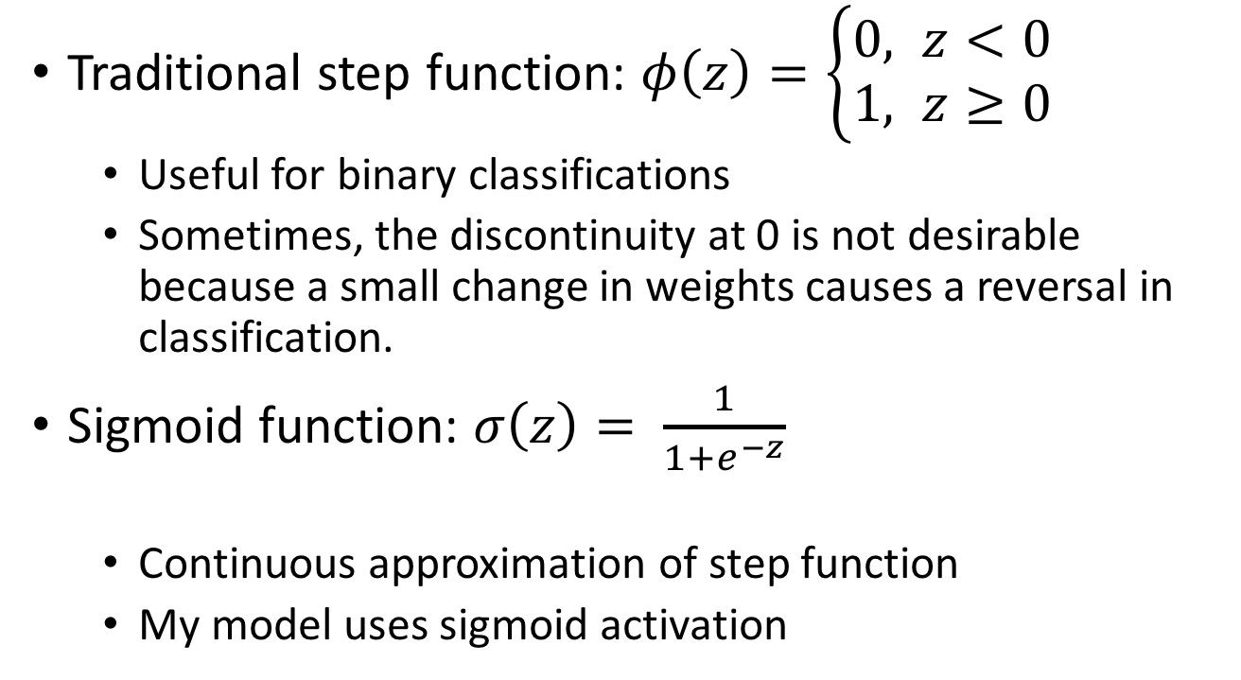
Activation Function
Traditional step function: $φ\left(z\right)=\left\{\begin{aligned}0, z<0 \\ &1, z≥0\end{aligned}\right.$
Useful for binary classifications
Sometimes, the discontinuity at 0 is not desirable because a small change in weights causes a reversal in classification.
Sigmoid function: $σ\left(z\right)= \frac{1}{1+e^{−z}}$
Continuous approximation of step function
My model uses sigmoid activation

Slide 46
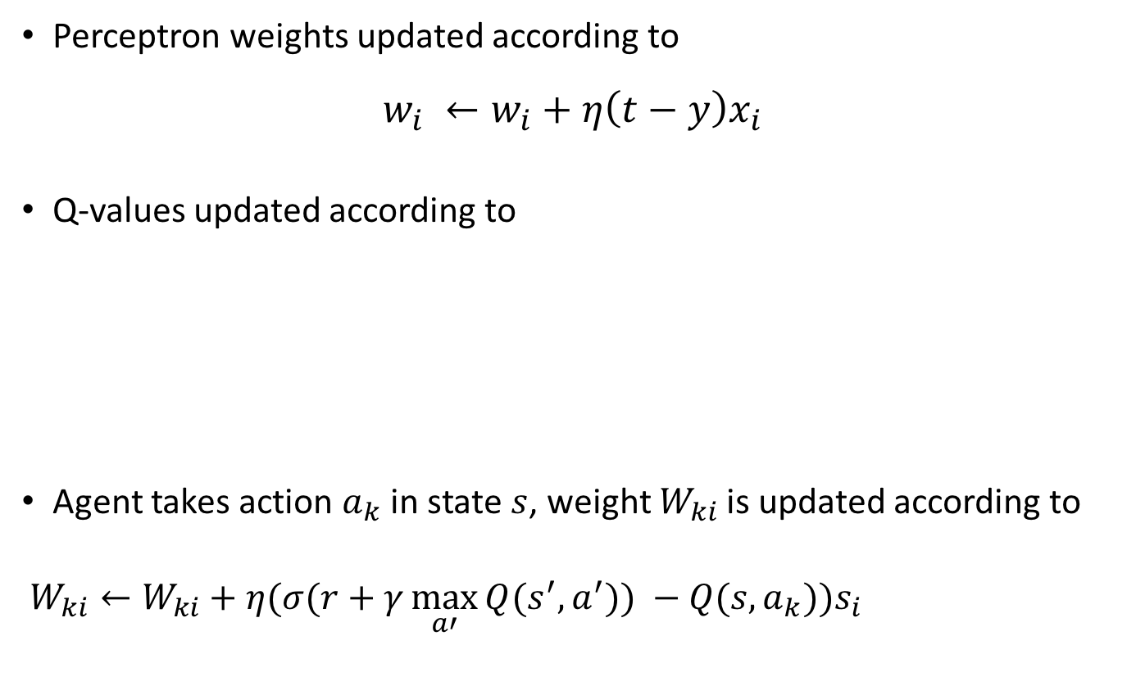
Update Rule for Q-Learning with Perceptrons
Perceptron weights updated according to
$$w_{i} ←w_{i}+η\left(t−y\right)x_{i}$$
Q-values updated according to
Agent takes action $a_{k}$ in state $s$, weight $W_{ki}$ is updated according to
$W_{ki}←W_{ki}+η(σ(r+γ\max_{a′}{Q(s^{′},a^{′})) −Q(s,a_{k}))s_{i}}$
target
perceptron output
$$Q\left(s, a\right)←Q\left(s,a\right)+η[r+\underset{a^{′}}{γmax}{Q\left(s^{′},a^{′}\right)−Q(s,a)]}$$
target
old Q-value
target
perceptron output

Slide 47
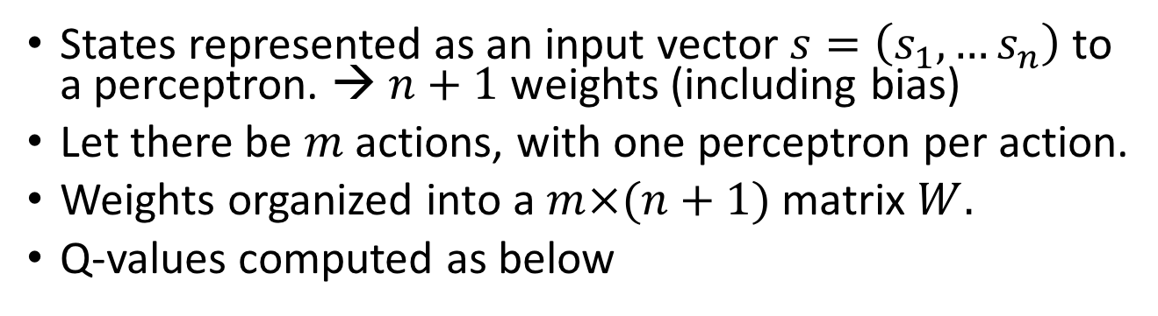
Back to Q-Learning
States represented as an input vector $s=\left(s_{1},…s_{n}\right)$ to a perceptron. → $n+1$ weights (including bias)
Let there be $m$ actions, with one perceptron per action.
Weights organized into a $m×(n+1)$ matrix $W.$
Q-values computed as below

Slide 48
3. Methods

Slide 49
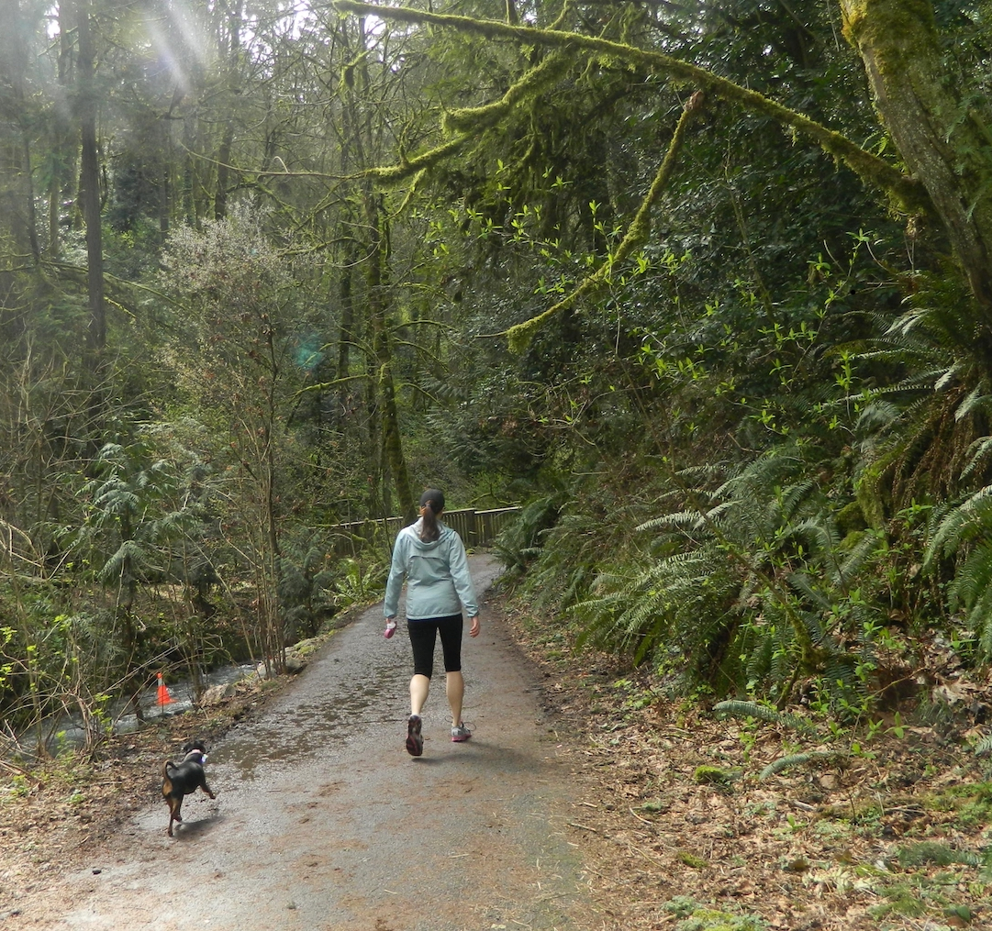
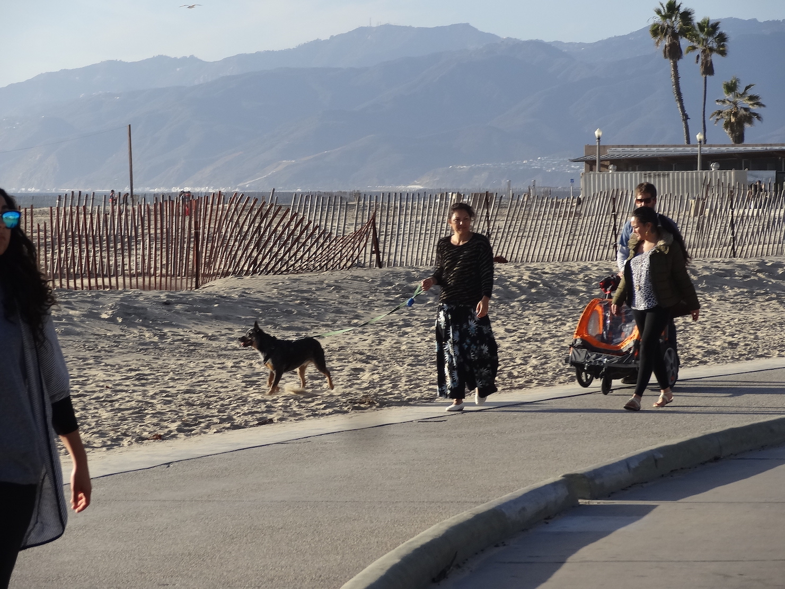
Dataset:
Portland State Dog Walking Images
Contains human-drawn ground truth labels for dogs, and humans.
For each object category (dogs, humans), I split images into training set of size 400, and a test set of size 100

Slide 50
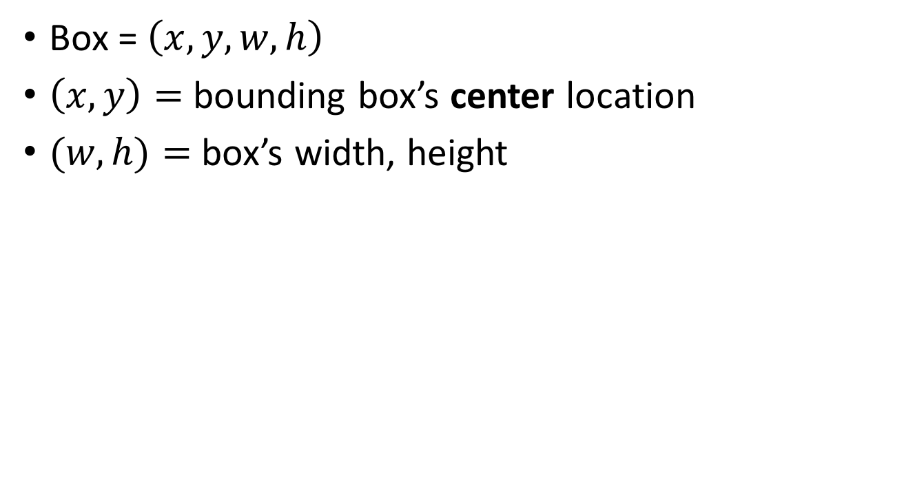
Bounding Box representation
Box = $\left(x,y,w,h\right)$
$\left(x,y\right)=$ bounding box’s center location
$(w,h)=$ box’s width, height
Notes:
In the actual code, I use top-left, but it’s easier to represent action definitions with x,y as center

Slide 51
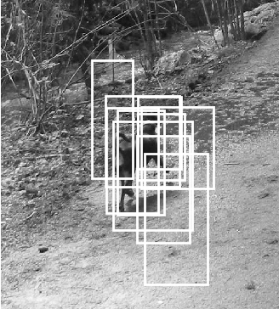
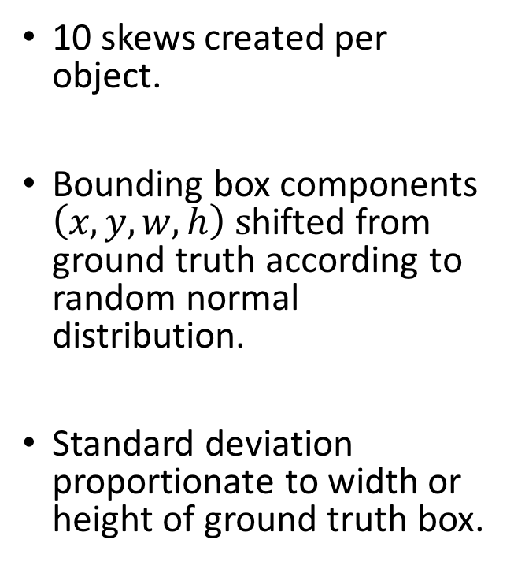
Generating Initial Bounding Boxes (skews)
10 skews created per object.
Bounding box components $\left(x,y,w,h\right) s$hifted from ground truth according to random normal distribution.
Standard deviation proportionate to width or height of ground truth box.

Slide 52
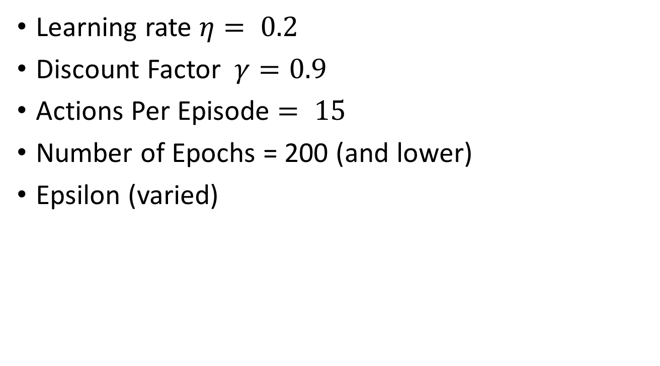
Parameters
Learning rate $η= 0.2$
Discount Factor $γ=0.9$
Actions Per Episode $= 15$
Number of Epochs = 200 (and lower)
Epsilon (varied)

Slide 53
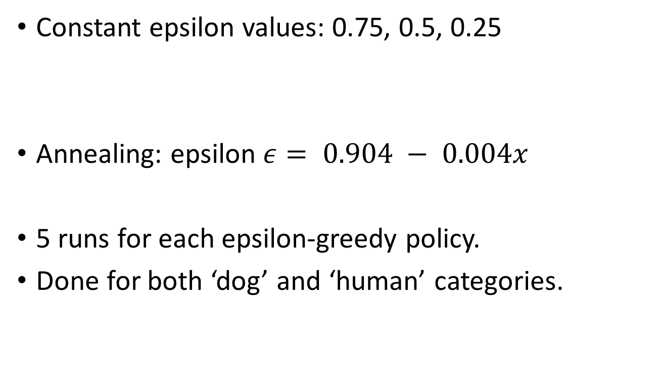
Experiment Design
Constant epsilon values: 0.75, 0.5, 0.25
Annealing: epsilon $ε= 0.904 − 0.004x$
5 runs for each epsilon-greedy policy.
Done for both ‘dog’ and ‘human’ categories.
(mostly exploration), (evenly balanced), (mostly exploitation)

Slide 54
Testing
100 images x 10 skews/image = 1000 examples
Algorithm mostly same as training: 15 actions per episode
Actions chosen solely on Q-value (epsilon = 0)
Weights are not updated (no need to compute rewards)
Performance measures:
Average Change in IOU
Success Rate = Fraction of bounding boxes improved.

Slide 55
4. Results

Slide 56
Effect of Epsilon 1 – Average change in IOU

Slide 57
Effect of Epsilon 2 – Success Rate (percent improved)

Slide 58
Effect of Initial Bounding Box IOU-Value Dogs
Highest performing ‘dog’ category run with annealing:
Mean IOU Improvement = 0.135,
Success Rate = 78.9%

Slide 59
Effect of Initial Bounding Box IOU-Value – Humans
Highest performing ‘human’ category run with annealing:
Mean IOU Improvement = 0.143,
Success Rate = 78.4%

Slide 60
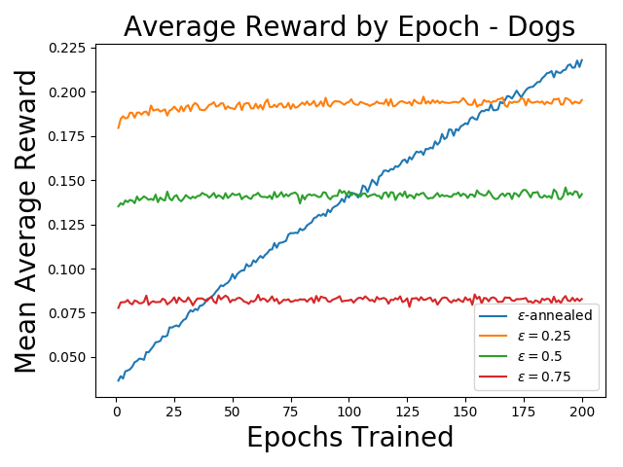
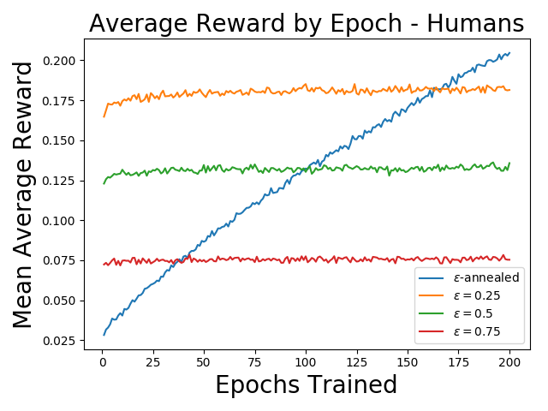
Average Reward Per Episode

Slide 61
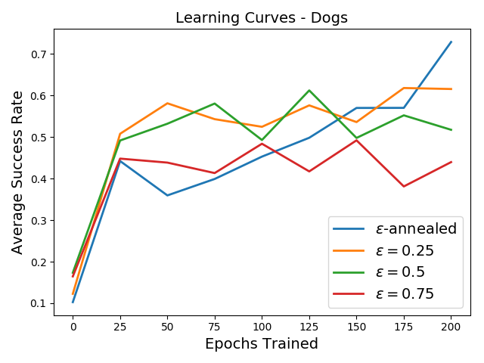
Effect of Number of Epochs Success Rate by Epoch - Dogs

Slide 62
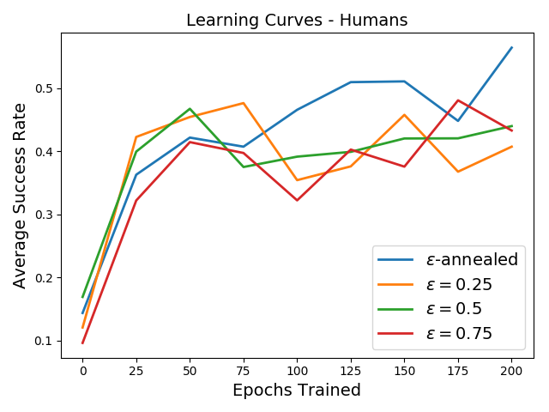
Effect of Number of Epochs Success Rate by Epoch - Humans

Slide 63
5. Conclusion and Future Work

Slide 64
Conclusions and Future Work
Annealing appears to work best
Annealing runs may be under trained.
Performance higher for dogs than humans- why?
Other future work:
Use CNN features
More sophisticated stopping mechanism – stop action triggers end of episode.
Rigorous comparison with bounding box regression.

Slide 65
End

Slide 66
Additional Slides

Slide 67

Training Algorithm
For epoch=1 to 200:
Shuffle the training set;
For each (img, skew) in training set:
current_box ← skew;
Initialize state $s$ ← HOG features from skew, 0 history vector;
For step = 1 to 15:
Select action $a$ according to epsilon-greedy.;
Take action $a$ to obtain new_box;
Add $a$ to history vector;
Extract HOG features from new_box and combine with history vector to obtain state $s′$;
Compute change in IOU-value to obtain reward $r$;
Compute $\max_{a′}{Q(s^{′}, a^{′})};$
Update perceptron weights according to
$w_{i}←w_{i}+η(σ(r+γ\max_{a′}{Q(s^{′},a^{′})) −Q(s,a))s_{i}}$
current_box ← new_box;
$s$ ← $s′$ ;

Slide 68

Cell Phone Apps (Google Lens)

Slide 69
Robot Control
Source
Notes:
Video courtesy of Tomás Donoso, Dalle Molle Institute for Artificial Intelligence (IDSIA) in Lugano, Switzerland
http://robotics.idsia.ch/media/videos.html

Slide 70
Self-Driving Cars
Source
Notes:
https://www.xsens.com/customer-cases/vector-ai-shaping-the-future-for-autonomous-driving/

Slide 71
Medical Imaging
Blood cell classification from:
G. Karkavitsas, M. Rangoussi Object localization in medical images using genetic algorithms
Notes:
https://waset.org/publications/6138/object-localization-in-medical-images-using-genetic-algorithms
Object localization in medical images using genetic algorithms George Karkavitsas and Maria Rangoussi
World Academy of Science, Engineering and Technology International Journal of Medical and Health Sciences Vol:1, No:2, 2007

Slide 72

Markov Decision Processes
RL Models are typically represented as Markov Decision Processes
Markov Decision Processes (MDP) have the following components:
$S=$ Set of states, including initial state $s_{0}$ and terminal state $s_{T}$
$A=$ Set of actions agent may take
Transition rules that determine the next state given the previous state and the action taken by the agent. The transition rules may be probabalistic: $P\left(s_{t+1}=s′\right|s_{t}=s,a_{t}=a)$
Reward function $r(s,a)$
$γ=$discount factor. Weighs value of future rewards against present reward.

Slide 73
Histogram of Oriented Gradients
Image region divided into cells,
Within each cell, gradients are computed, (change in intensity with respect to x and y)
Gradients compiled into histograms organized by cell.
Bins separated by orientation
0-180° for unsigned gradients (which I use)
0-360 ° signed gradients
Gradients normalized by “block”, which is a larger region encompassing each cell.
scikit-image Library used to compute HOG [2].

Slide 74

HOG Examples

Slide 75
HOG, continued
Block: 3x3 cells
Cell:
16x16 pixels
180° divided into 9 histogram bins
HOG array shape: (6, 6, 3, 3, 9) → HOG Feature vector with 6 x 6 x 3 x 3 x 9 = 2916 features
blocks
cells
bins
Notes:
- 6x6 array of blocks, each containing 3x3 array of cells, each containing 9-bin histogram.
-

Slide 76

State Definition
State vectors are a concatenation of HOG features drawn from the bounding box, and history features.
HOG array shape: (6, 6, 3, 3, 9) → HOG Feature vector with 6 x 6 x 3 x 3 x 9 = 2916 features
Action history vector:
Each action encoded as a length-9 bit vector.
Last ten actions are recorded
So history vector has $9×10=90$ features
Combined state vector: $2916+90=3006$ features

Slide 77

Action definitions
Given a bounding box $b=\left(x,y,w,h\right):$
left/right: $x ←x±αx$
up/down: $y ←y±αh$
bigger/smaller: $w←w±αw, h←h±αh$
fatter: $w←w+αw$
taller: $h←h+αh$
stop: no change in $b$
Shift factor $α=0.1$
Notes:
In preliminary experiments, I found alpha = 0.1 to work better that 0.2, which was too aggressive, causing bounding boxes drift away from ground truth entirely. Alpha <0.1 would make it hard to make sufficient progress toward its goal in 15 actions.

Slide 78

Training Algorithm
Repeat for N epochs:
For each (img, skew) in training set:
current_box ← skew;
Initialize state $s$ ← HOG features from skew, 0 history vector;
For action = 1 to 15:
Agent adjusts the box according to to epsilon-greedy. State $s^{′}$ obtained;
Compute change in IOU-value to obtain reward $r$;
Update perceptron weights;
$w_{i}←w_{i}+η(σ(r+γ\max_{a′}{Q(s^{′},a^{′})) −Q(s,a))s_{i}}$
current_box ← new_box;
$s$ ← $s′$ ;

